Slide 1
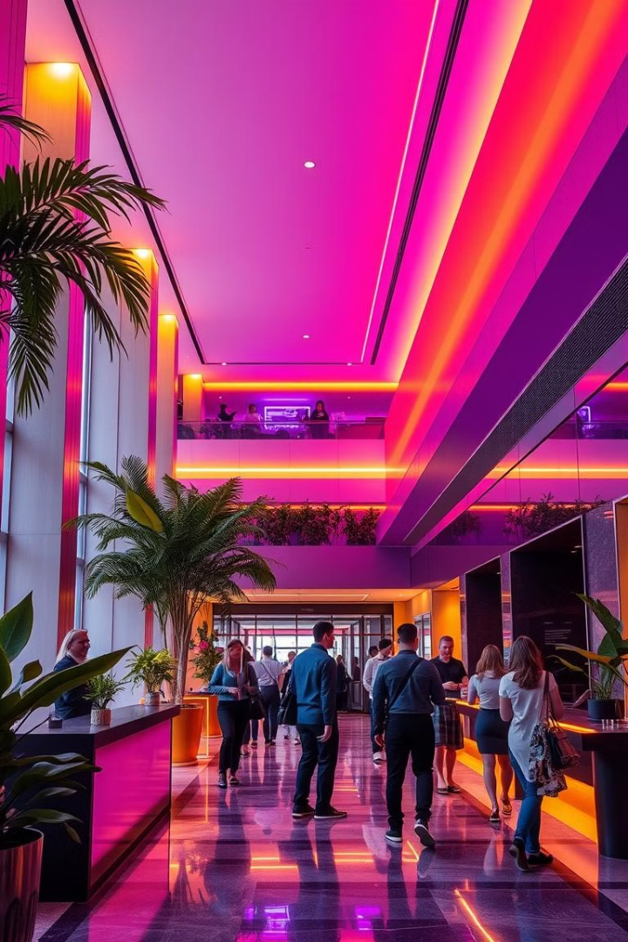
AI-Powered Guest Experience Personalization System for Hospitality

Slide 2
Project Objectives
Enhanced Guest Experience
Automated Feedback Analysis
Operational Efficiency
AI-driven personalized recommendations for dining, activities, and amenities
Real-time sentiment monitoring to address guest concerns proactively
Streamlined staff notifications and data-driven decision-making for better service

Slide 3
Coupon Recommendation: Modeling
Data Collection
Feature Engineering
Model Training
Personalization
Gather historical guest data. Include demographics, preferences, and booking history.
Extract key features. Include stay duration, spending habits, and service usage.
Train machine learning models. Use algorithms like collaborative filtering.
Tailor coupons to guest profiles. Increase engagement and satisfaction.

Slide 4
Coupon Recommendation: Modeling
Features
Model
Procedure
We analyzed guest spending history and meal preferences.
We used XGBoost to handle null values efficiently.
The system begins with data preprocessing.
Seasonal trends were also analyzed for optimal results.
XGBoost is effective for structured data and prediction.
This is followed by feature selection and model training.

Slide 5
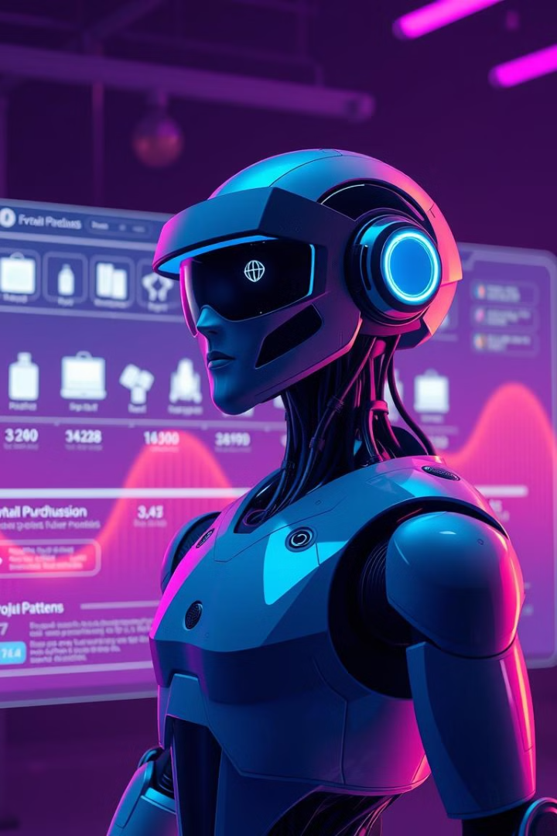



Coupon Predictor: Output
Probabilities
The system predicts the likelihood of guest purchases.
Top Predictions
It suggests top offers to maximize engagement.
XGBoost
The model's robustness made it the best option.

Slide 6

Review Analyzer: RAG System
Purpose
Retrieval
It analyzes guest reviews, extracts sentiments dynamically.
RAG is used to generate responses based on data.
Storage
The data is embedded and stored in a vector database.

Slide 7

RAG System: How It Works
1
Embedding
Guest reviews are embedded into vector representations.
2
Storage
Vectors are stored in a vector database for efficient retrieval.
3
Query
Queries fetch relevant cases for dynamic sentiment analysis.

Slide 8
Booking Page & Review Analysis
UI for Customers
Real-Time Reviews
Allows seamless hotel bookings via a custom user interface.
Continuously analyzes feedback, updating guest profiles.

Slide 9
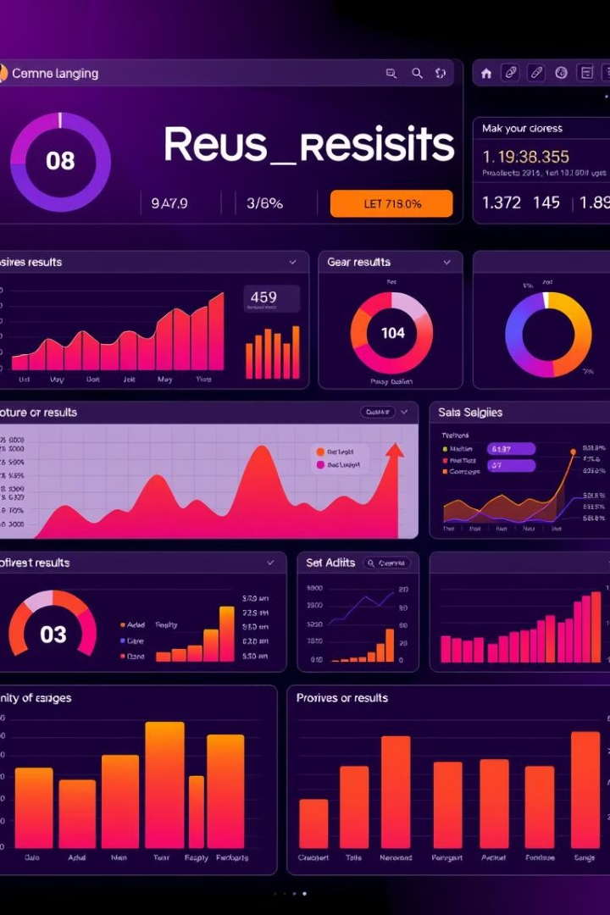
Implemented Features Overview
1
ML Model
Predicts guest's next dish purchase.
2
Integrated UI
Provides seamless hotel bookings for users.
3
Discount Suggestions
Offers ML-powered suggestions for dining.
4
RAG Integration
Integrates review analysis into the UI.

Slide 10




Key Takeaways
AI enhances guest experiences.
Predictive models drive engagement.
Real-time analysis improves service.

Slide 11
Thank-You

